Slide 1
Latency
Dr.Mohammed Abdalla Mahmoud Youssif
1

Slide 2
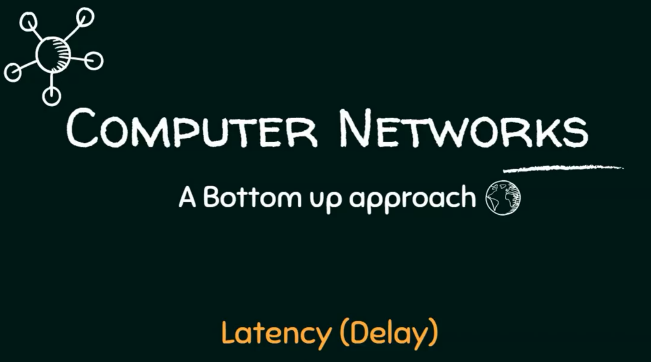
2
Notes:
2

Slide 3
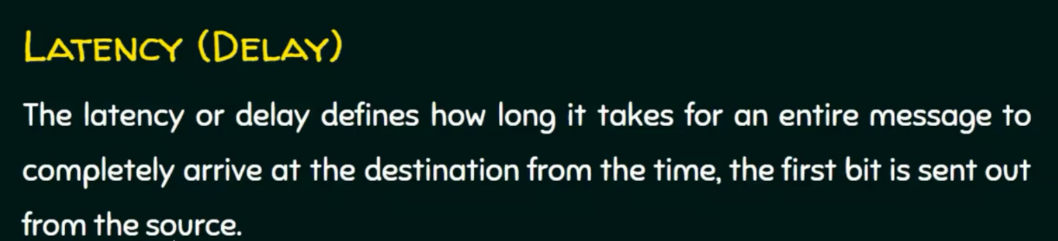
3
Notes:
3

Slide 4
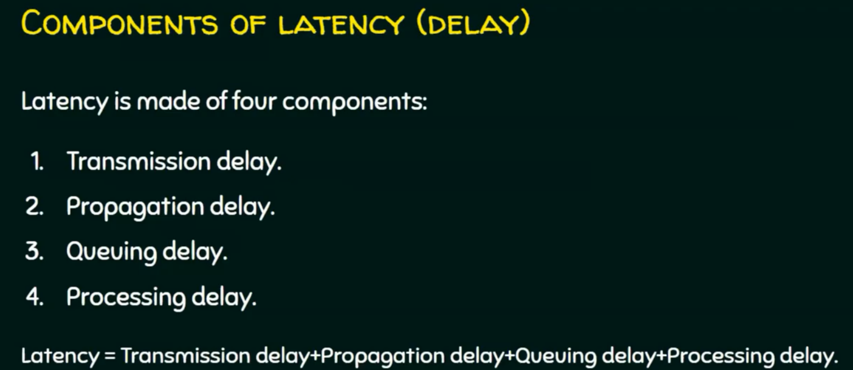
4
Notes:
- Transmission delay or transmission time
- 6++
Queuing delay or queuing time.
Processing delay or processing time.
4

Slide 5
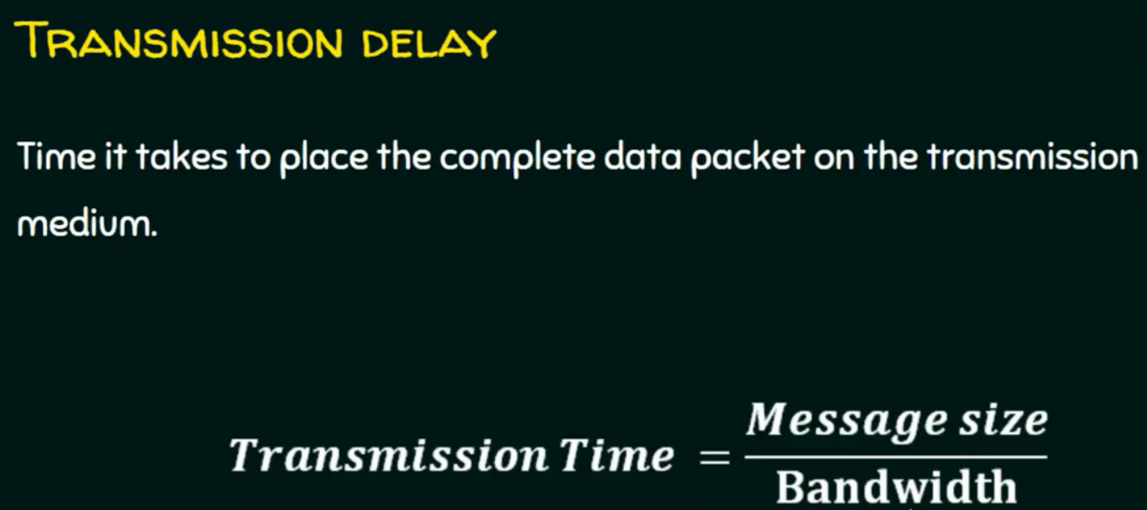
5
Notes:
5

Slide 6
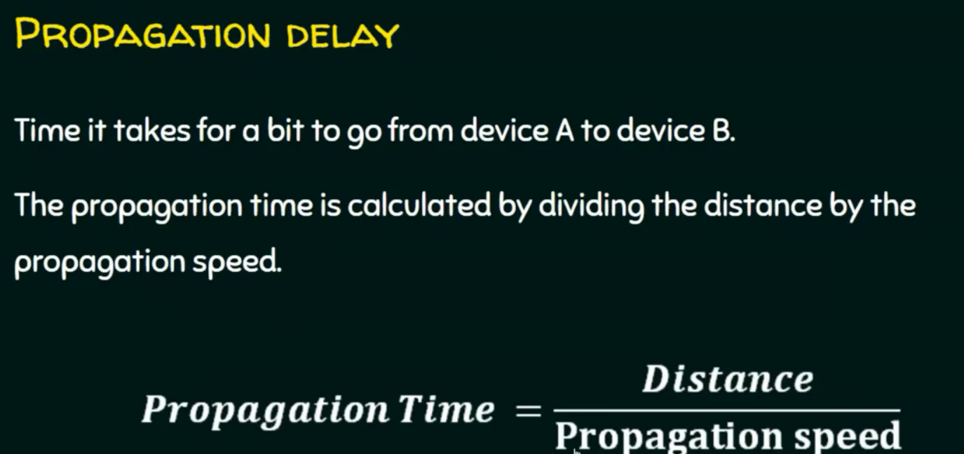
6
Notes:
6

Slide 7
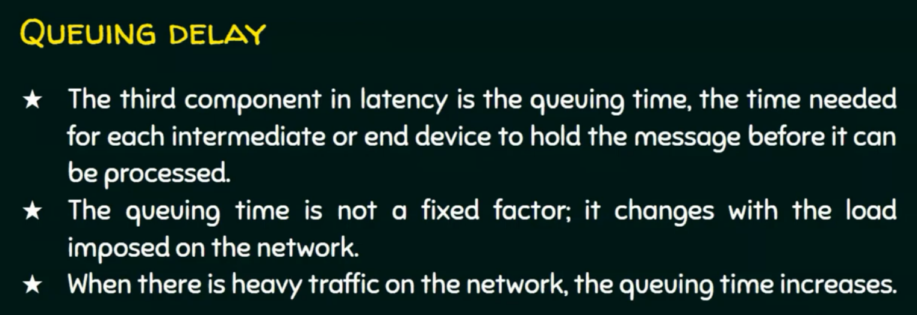
7
Notes:
7

Slide 8
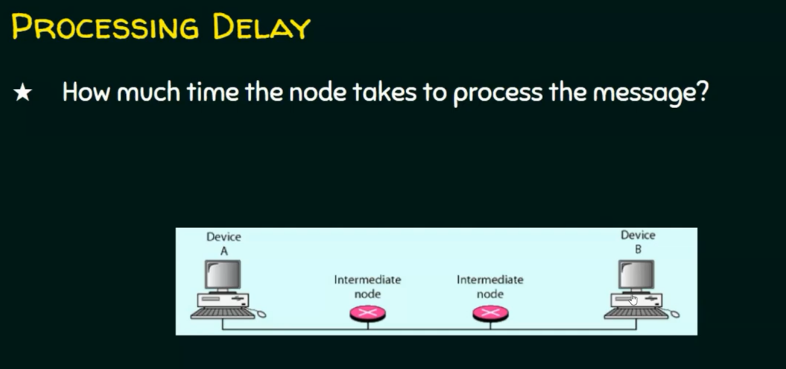
8
Notes:
- mainly the latency depends on 2 delays the transmission delay and propgation delay.
8

Slide 9
Questions ?
9
Notes:
9

